Slide 1


Understanding the effect of sampling effort
on covid-19 case numbers
Presenter: LBDB3
Discipline: Statistics (medical statistics)
Supervisor: Dr. Manolopoulou Ioanna

Slide 2
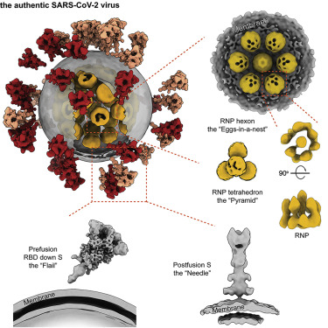

Covid-19
In the end of 2019, the new coronavirus, severe acute respiratory syndrome coronavirus 2 (SARS-CoV-2), outbroke in China and soon all countries (North Korean is unknown) suffer from this new diseases.
This coronavirus disease is named after : COVID-19.
Figure1: Molecular Architecture of the SARS-CoV-2 Virus (Yao et al. 2020)
Notes:
Yao, Hangping, Yutong Song, Yong Chen, Nanping Wu, Jialu Xu, Chujie Sun, Jiaxing Zhang, Tianhao Weng, Zheyuan Zhang, Zhigang Wu, Linfang Cheng, Danrong Shi, Xiangyun Lu, Jianlin Lei, Max Crispin, Yigong Shi, Lanjuan Li, and Sai Li. "Molecular Architecture of the SARS-CoV-2 Virus." Cell 183.3 (2020): 730-38.e13. Web.

Slide 3
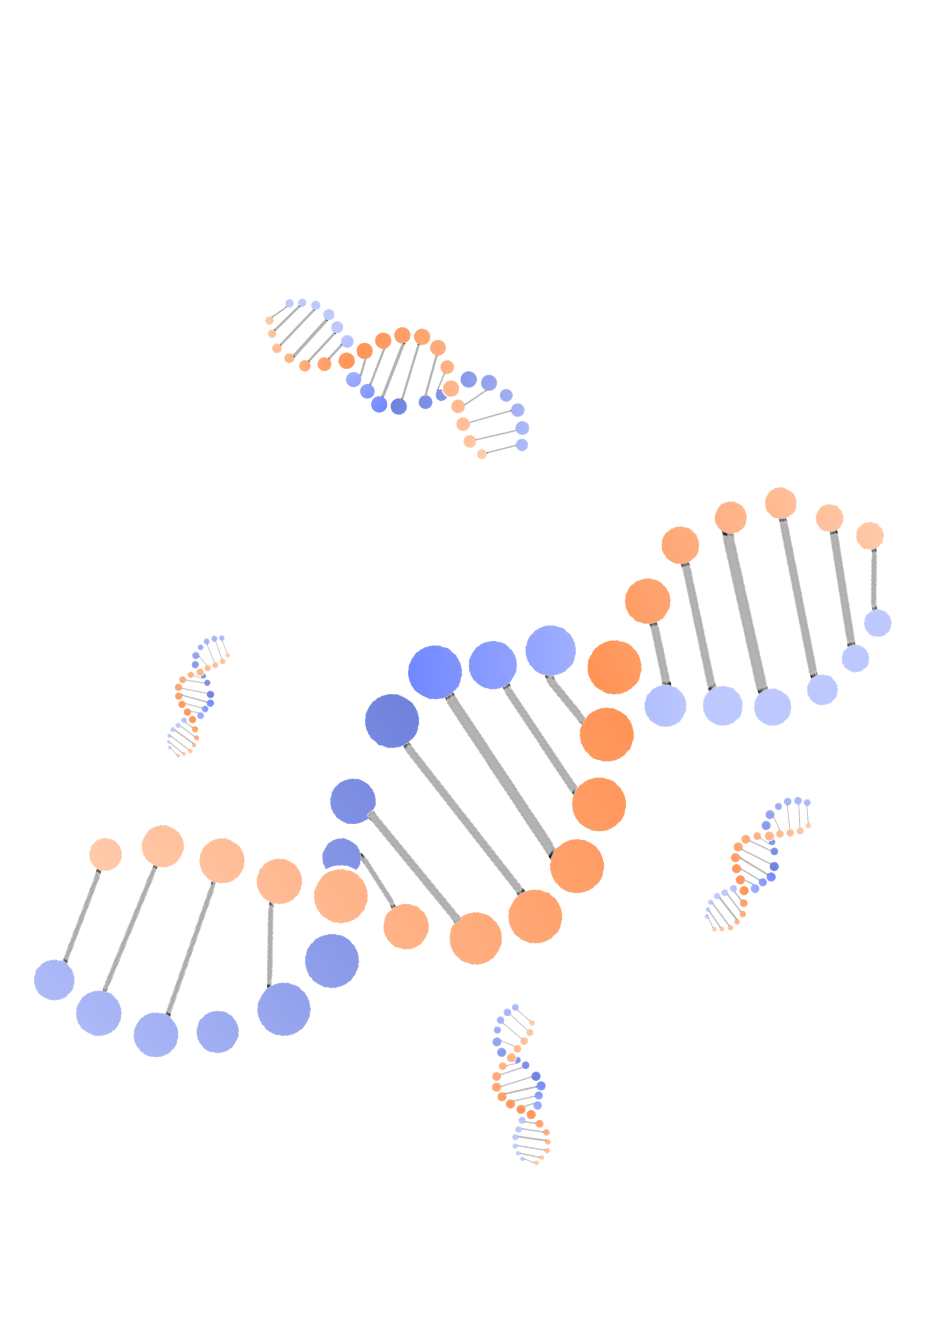

01
Introduction
02
The regularity of the infection
Outline
03
Precautionary measures
04
Conclusion
Notes:
My presentation would be divided into this 4 parts

Slide 4
Thesis statement
Although the daily increasing cases reported by the UK government are always underestimated due to the limitation of test ability and some testing policies, the effectiveness of testing is constantly improving with some ups and downs and reached 23.77% with 95% Confident Interval of (8.81%, 66.64%) before the 1st October 2020, when is the last of the study span of this thesis.
Notes:
The overall finding of my thesis this that: the daily increasing cases reported by the UK government are always underestimated and the effectiveness of testing is constantly improving with some ups and downs before the 1st October 2020, when is the last of the study span of this thesis.

Slide 5
Introduction
Notes:
First

Slide 6
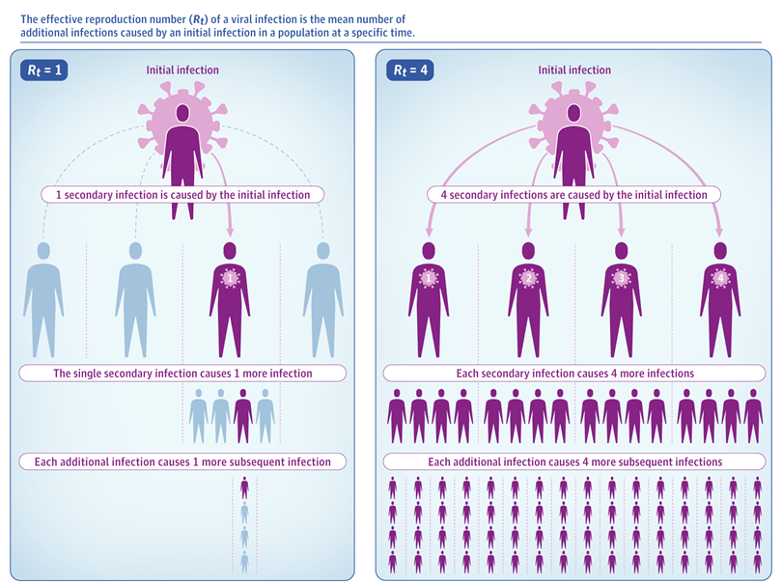
Basic Reproduction Number (R_{t} )
R_{t} represents the average number of infections produced by each infected case.
(Flaxmanet al., 2020)
The R_{t} value indicates the direction of change.
However, the R_{t} value alone does not indicate how quickly an epidemic is changing.
Figure2: The diagrammatic sketch of the R_{t} (Thomas 2020)
Notes:
R_{t} is a basic epidemiological number, which represents the average number of infections produced by each infected case during the course of infection (Flaxmanet al., 2020)
If R is 0.5 then, on average, for each 2 infected people there will be only 1 new infection. The R value indicates the direction of change, with a value greater than 1 meaning the epidemic is growing and a value less than 1 meaning the epidemic is shrinking. However, the R value alone does not indicate how quickly an epidemic is changing because it does not take into account the time taken for each transmission to take place. by the way, the series interval is able to assess the transmission speed of the epidemics.
Inglesby, Thomas V. "Public Health Measures and the Reproduction Number of SARS-CoV-2." JAMA : The Journal of the American Medical Association 323.21 (2020): 2186-187. Web.
Seth Flaxman, Swapnil Mishra,Axel Gandy, H Juliette T Unwin, Thomas A Mellan,Helen Coupland, Charles Whittaker,Harrison Zhu,Tresnia Berah,Jeffrey W Eaton,et al. Estimating the effects of non-pharmaceutical interventions on covid- 19 in europe. Nature, 584(7820):257-261,2020.

Slide 7

Non-Pharmaceutical Intervention (NPI)
The study span of this thesis is from 1st Frbrurary to 1st October 2020, before the first vaccine has been injected in the UK. Hence at that time NPI was the only effective method to contain the Covid-19 by deceasing the R_{t}. However, there are many people in the UK protest for the NPI policies becasuse of the freedom.
Notes:
The study span of this thesis is from 1st Frbrurary to 1st October 2020, before the first vaccine has been injected in the UK on the 8th December. Hence at that time NPI was the only effective method to contain the Covid-19.
The NPI policy response to COVID-19 can be complex. These policies can be at a country level or a local level. Different countries resort to different methods to manage the pandemic. NPI usually contains closings of schools and universities, closings of workplaces, canceling public events, limits on gatherings, closing of public transport, stay at home requirements, restrictions on internal movement between cities/regions, and restrictions on international travel. As the epdemic upwards, the restriction of these NPI policies would be eased.
However, there are many people in the UK protest for the NPI policies becasuse of the freedom. Particularly in June, because the search index of the protest in google peaked at that time

Slide 8
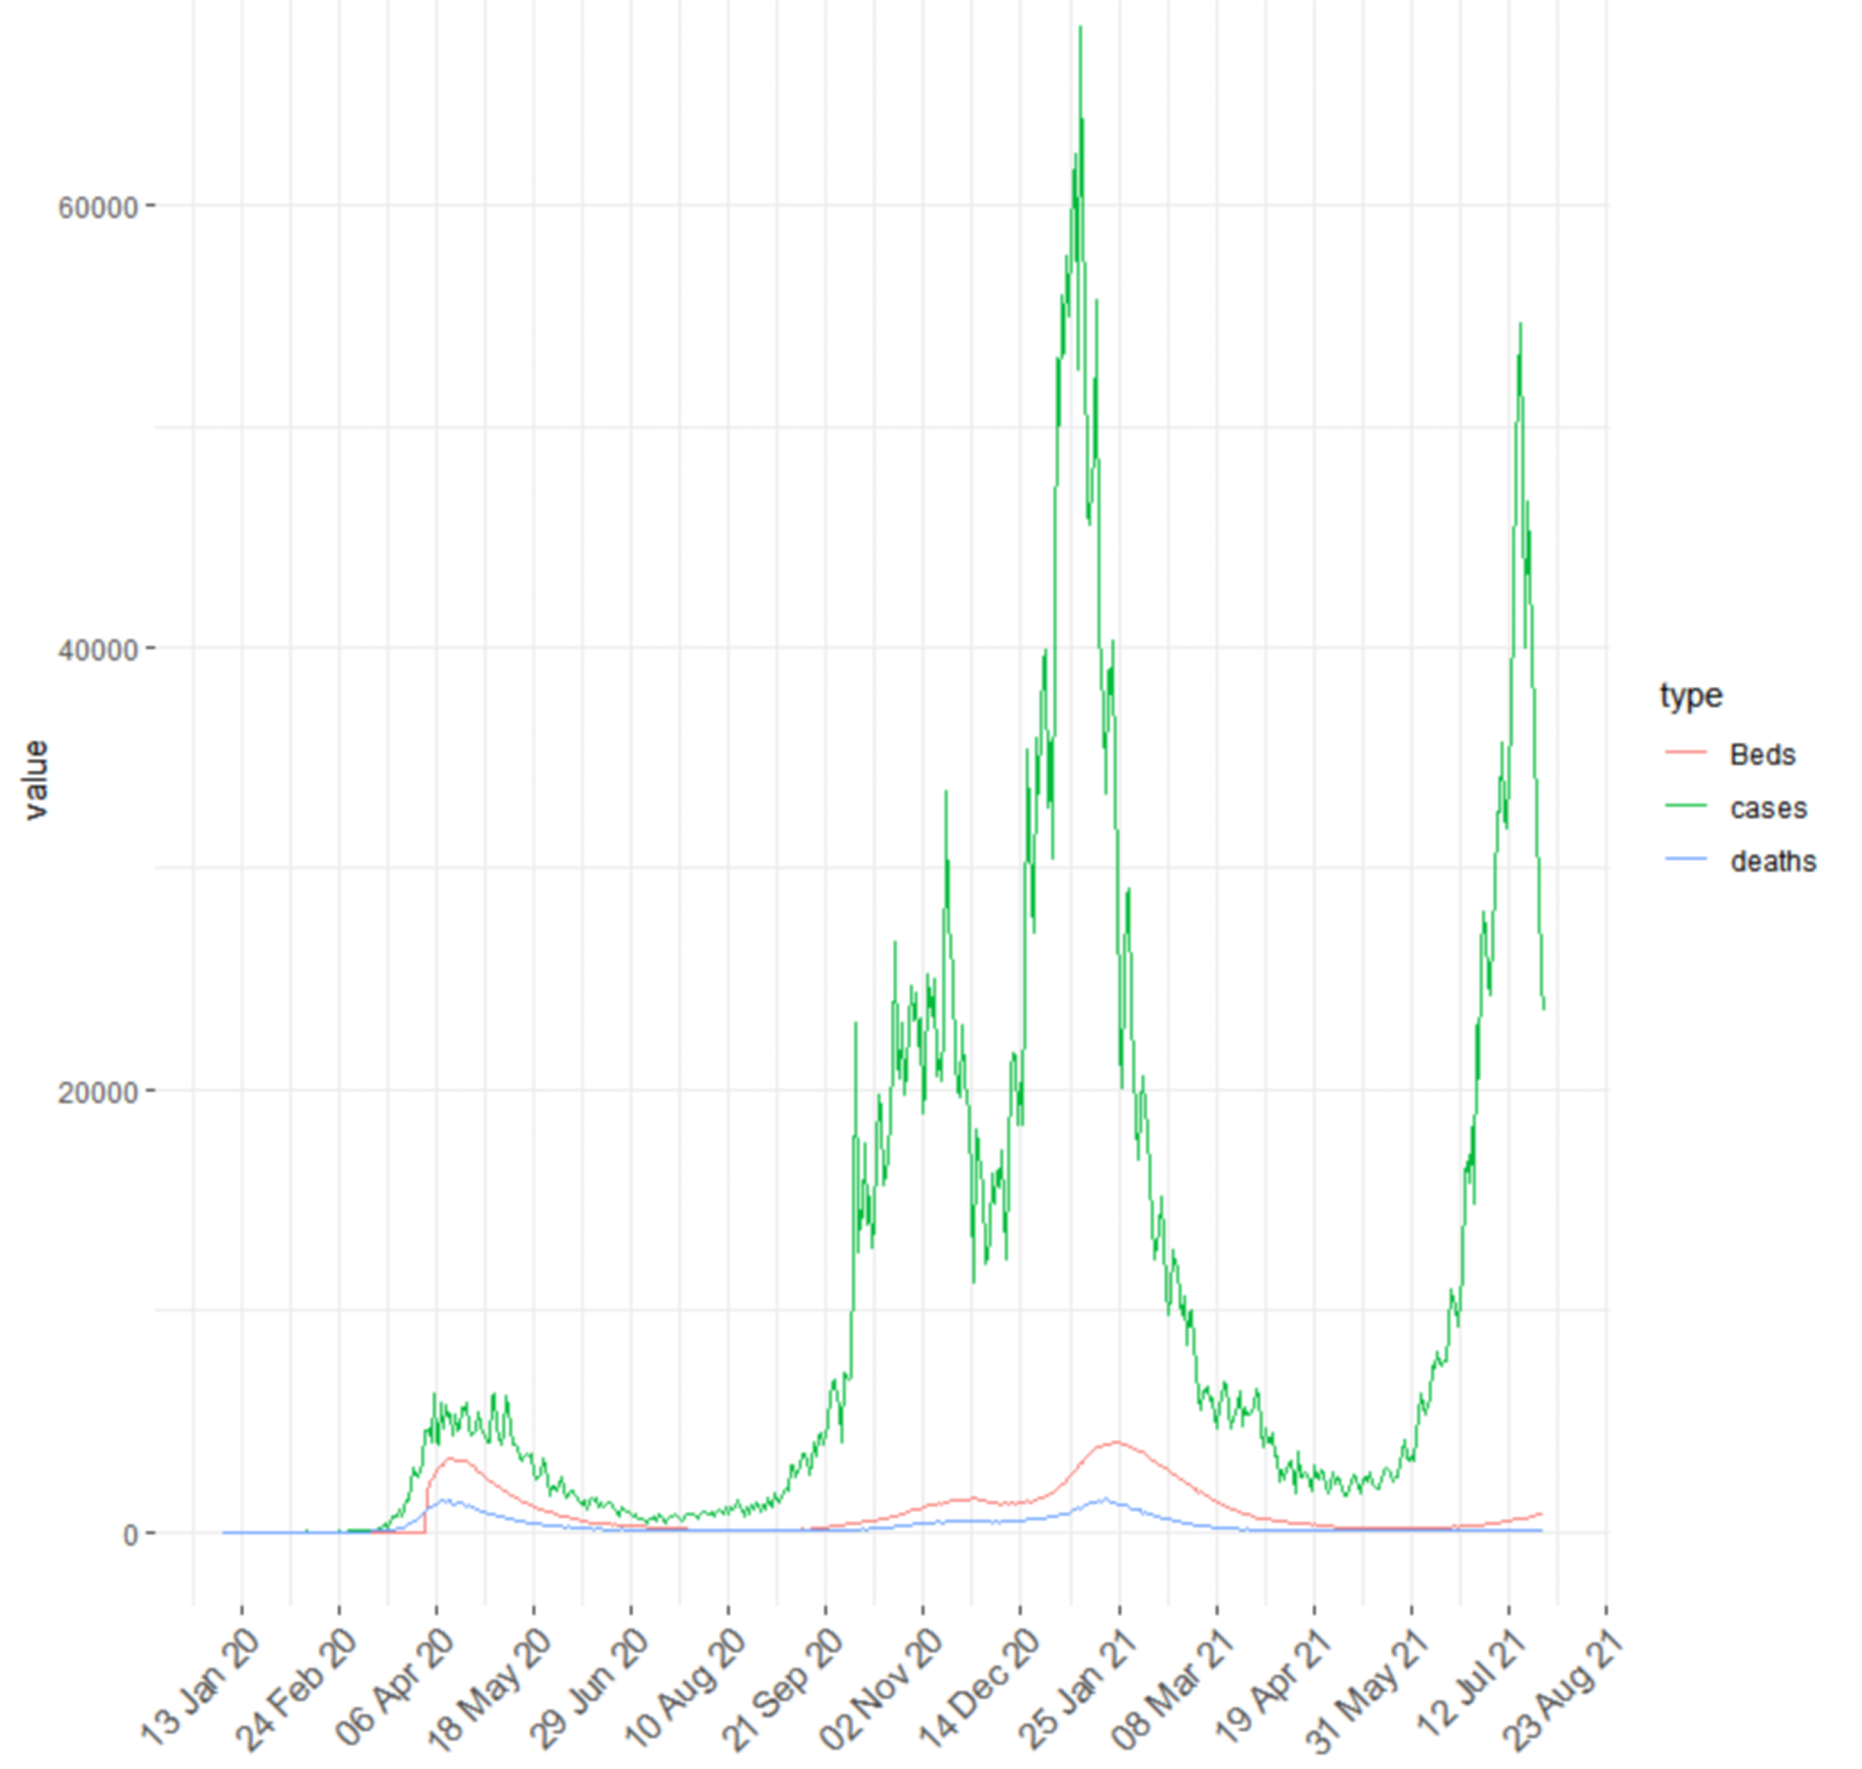
Waves of the epdemic
It can be observed that in the first two waves of the epidemic in the UK, the death and people in mechanical ventilation beds data are similar, but the detected cases in the first wave were significantly fewer.
Therefore, there is reason to believe that the reported data of detected infections is often biased downwards.
Figure 3:The daily increasing cases, deaths and in mechanical ventilation beds
Notes:
Figure 3 shows the daily increasing number of detected cases (green line), death (blue line), and people in mechanical ventilation beds (red) observed from Jan 2020 to August 2021. It can be observed that in the first two waves of the epidemic in the UK, the death and people in mechanical ventilation beds data are similar, but the detected cases in the first round were significantly fewer.
There is still a question remained, WHY it is impossible that the mortality of the second waves in greater less than the first wave, since the UK government has enough experience to contain the epdemic. The anwser is that the cornavirus has variant strains, which have greater mortality, higher R_t or even quick transmission speed. Focusing on the time span from october 1st to December 7th, the vaccine injection is still not avalible for the public.
Therefore, there is reason to believe that the reported data of detected infections is often biased downwards. and it is why I need to study the sampling effect on Covid-19. Also, from the figure 3, the prior sense of sampling effect is that, as the passage of time, the sampling effect is increasing.
I took the time span from October 1st as an example, because the first variant strain: alpha strain was found in the UK at October. Up to now, there are alpha, beta, delta, gamma, lambda strains in the world. Among them the delta strain is the most Notorious one because of the high mortality rate.

Slide 9
Thesis time span
31st Janurary 2020
1st October 2020
The first two COVID-19 cases in the UK were confirmed on January 31st, 2020, indicating the start of the epdemic in the UK
The first mutation of SARS-CoV-2 (Alpha Strain) in the world was found in the UK on October 2020, indicting the variant of the nature of SARS-CoV-2
Time span
Notes:
Based on the things introduced in the previous slide, the time span of the study could be determined. For the start, the first two covid-19 cases in the UK were confirmed on January 31st, and for the end, the cornavirus tended to mutate on October 2020, hard to be modeled. Hence the time span of my study is from 31st January to 1st October 2020.

Slide 10
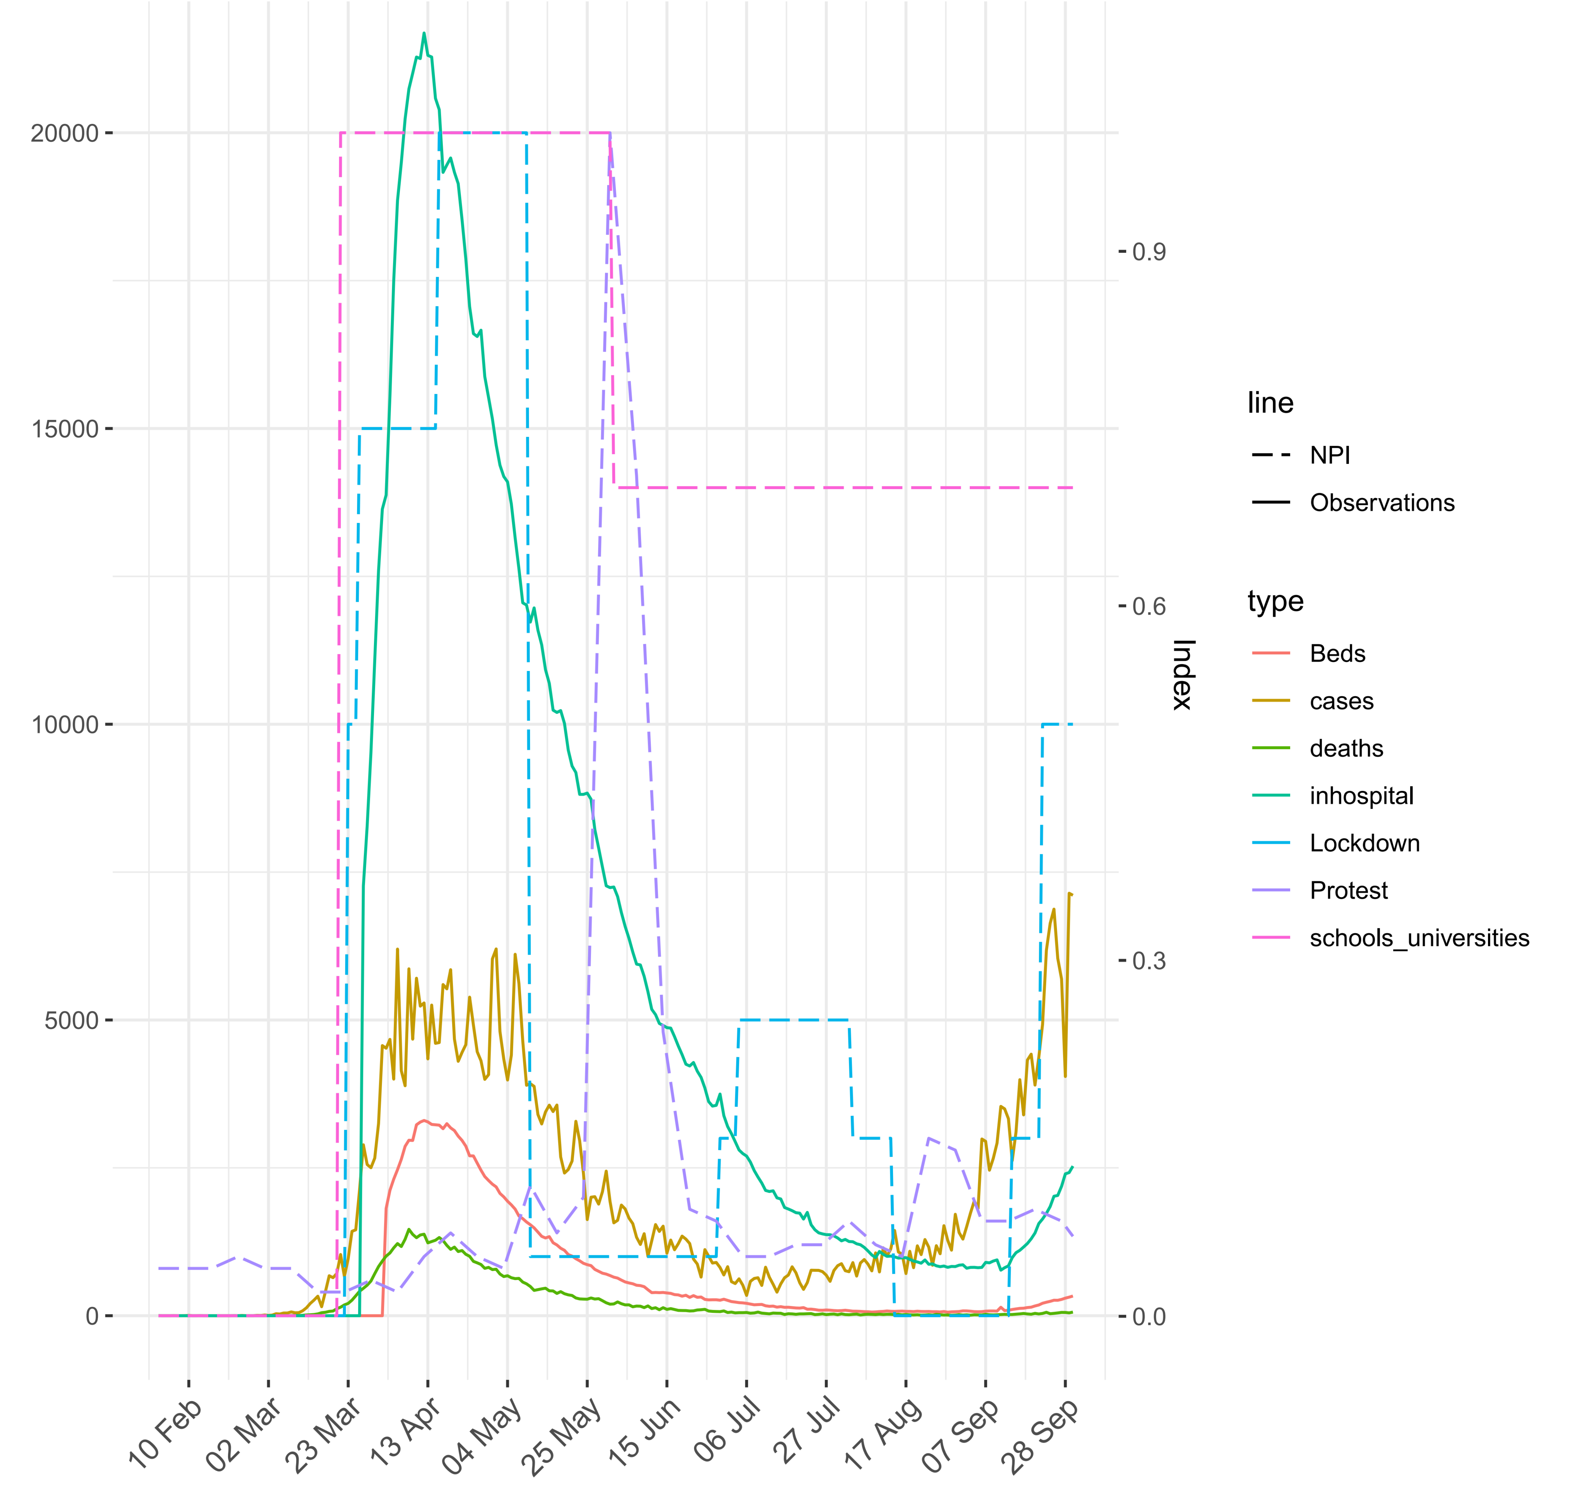
Data description
This figure shows the all data for this thesis. Observed cases, on the mechanical ventilation bedsbeds, death, and in hospital are solid lines. The dotted lines show the variables that describe the NPI policies, including lockdown, lockdown of schools and universities, and the protest index.
Figure 4:All data used from 31st Jan to 1st Oct 2020

Slide 11
Methodology
Notes:
First

Slide 12
Basic method
Markov chain Monte Carlo
Bayesian Linear Regression
In Bayesian statistics, the latest development of the MCMC method makes it possible to calculate large-scale hierarchical models that need to integrate hundreds to thousands of unknown parameters.
Bayesian linear regression is performed in the context of Bayesian inference. When a specific form of the prior distribution is assumed, the posterior probability distribution of the model parameters can get an explicit result.
Notes:
The main methods used in this thesis are Markov chain Monte Carlo simulation and Bayesian linear regression, as the result of these methods, the simulation result would be presented as a distribution and has high correlation with the prior and parameter distributions.

Slide 13
Model Assumptions
1
During the time span, the mutation of the cornavirus did not occur
2
The nature of the cornavirus will change only if it mutates
3
The antibodies in the cured patients do not affect further infections.
Notes:
For the first assumption. we have known that the first mutation alpha strain was found on October, but no one konws when the cornavirus mutated, therefore, this assumption should be held.
Because the MCMC and Beyasian regression has used. I assume all distributions used in this thesis are invariate. The nature of the cornavirus has many aspects such as serial interval, which means the time distribution of the transmission from patient to patient. and mortality rate, hospitalization rate,
At the end of my thesis time span, nearly 6% people in the UK has antibody, this rate is not so large. . It is known that a person can be infected twice with the Covid-19, but the probability of a second infection will be much less than the first time because of the appearance of antibodies in his/her body. However, in the time span of our research, the concentration of antibodies in the population was not high, so we ignored the adverse effects of antibodies in the time of the research

Slide 14
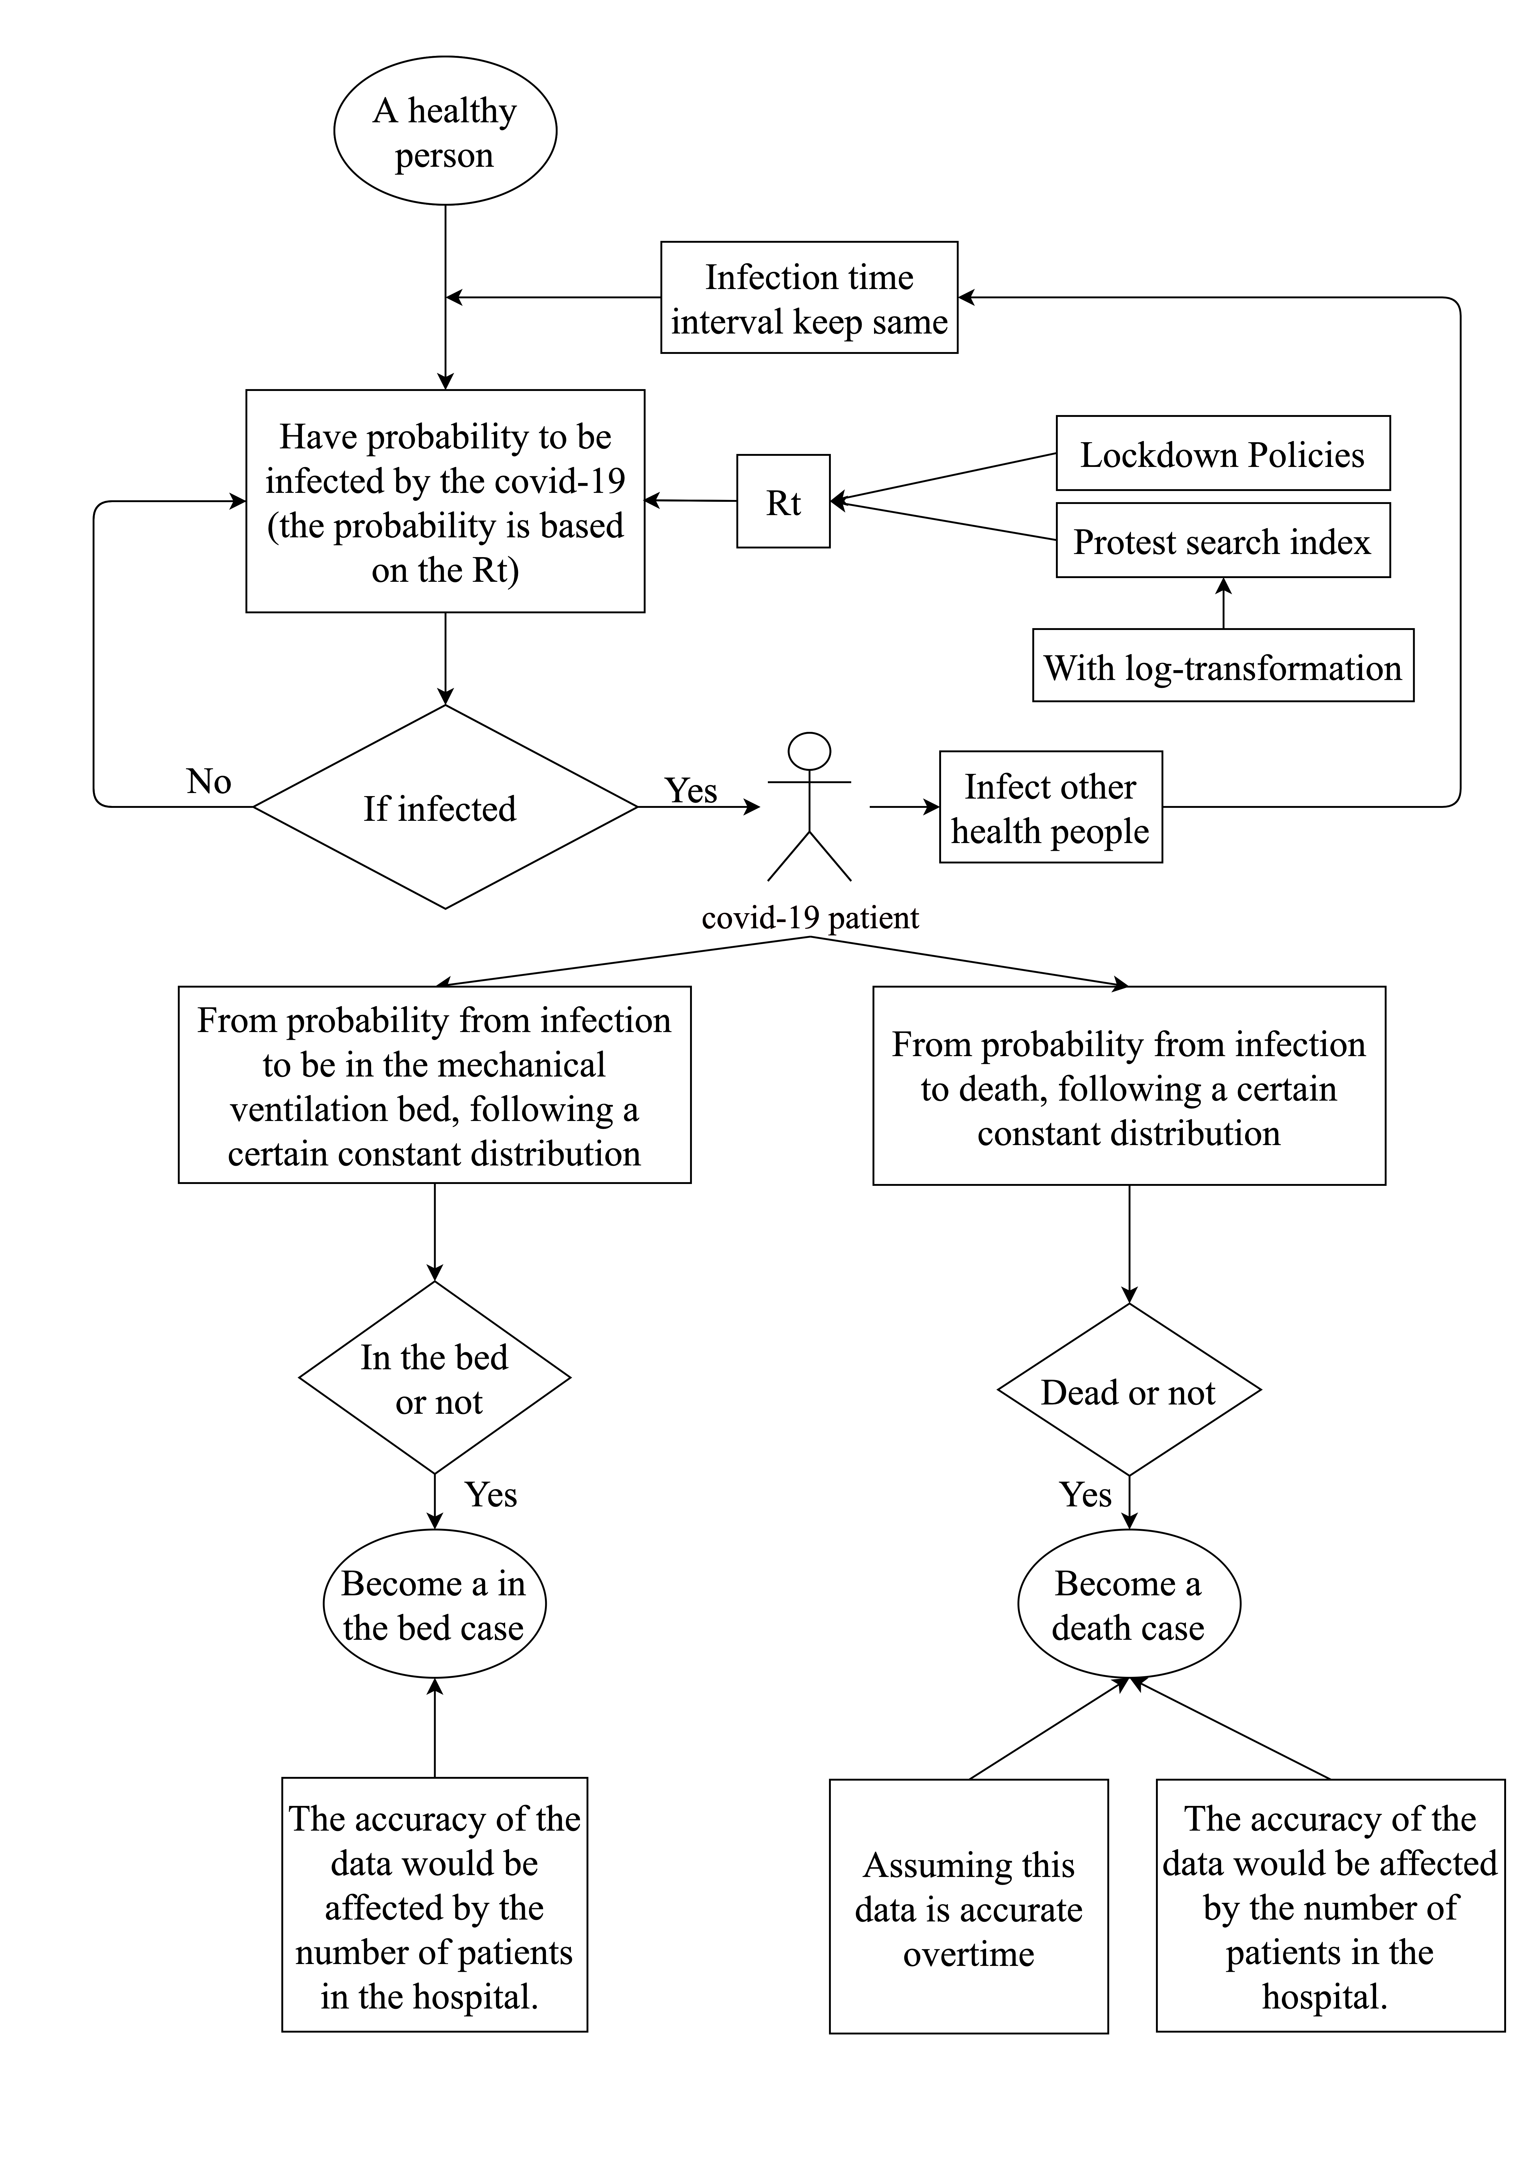
The way to simulate the sampling effect
Figure 5: the simulation process of the sampling effect
Notes:
In the beginning, the probability of a healthy person to be infected is determined by the Rt, and the time when the person is infected is affected the series interval. Besides, the calculation of the Rt is based on the state of NPI and search indexes of “protest” on google. Meanwhile, when the infection time interval keeps the same in a single day sampling from the distribution, it is worthy highlighting that the number of infected individuals will also boost the transmission. After being infected, the state of a person will have many situations, including unrecorded, deaths, admit to mechanical ventilation beds, in hospital and so on. Also the rate that patient admitted to the mechanical ventilation beds and mortality also conform constant distributions.
Furthermore the reported number of death or admitted to mechanical ventilation beds maybe not accurated, this model also to simulate the new these data if assuming they are inaccurate.

Slide 15
Reference list
Notes:
This is my reference list

Slide 16
Thanks for your attention
Presenter: LBDB3
Date：10th September 2021
Notes:
Please feel free to ask me questions

